Slide 1
Southampton Strategic Assessment National Child Measurement Programme
Dan King and Vicky Toomey
Intelligence & Strategic Analysis Team Southampton City Council
I
I

Slide 2
Contents
Context
How we measure obesity and National Child Measurement Programme (NCMP)
Local NCMP data analysis
NCMP - Benchmarking
NCMP - Trends
NCMP - Deep dive
NCMP - Linked analysis

Slide 3
Context - childhood obesity and NCMP

Slide 4
Context
The World Health Organization defines childhood obesity as:
“Abnormal or excessive fat accumulation that presents a risk to health''
“One of the most serious public health challenges of the 21st century."
Obesity as a risk factor for poor health and wellbeing….
In Children….
Range of adverse health outcomes such as asthma
Poor self esteem, mental health and stigmatisation
Risk factor for obesity in adulthood
In adults….
A leading cause of a range of conditions such as asthma and other respiratory problems, eating disorders, mental health disorders and psychosocial risks, cardiovascular diseases, Type 2 diabetes, musculoskeletal problems, sleep apnoea etc…..
Notes:
World Health Organization. Childhood overweight and obesity. http://www.who.int/dietphysicalactivity/childhood/en/
National Obesity Observatory. Health Risks of Childhood Obesity. 2016. http://www.noo.org.uk/NOO_about_obesity/child_obesity/Health_risks.

Slide 5
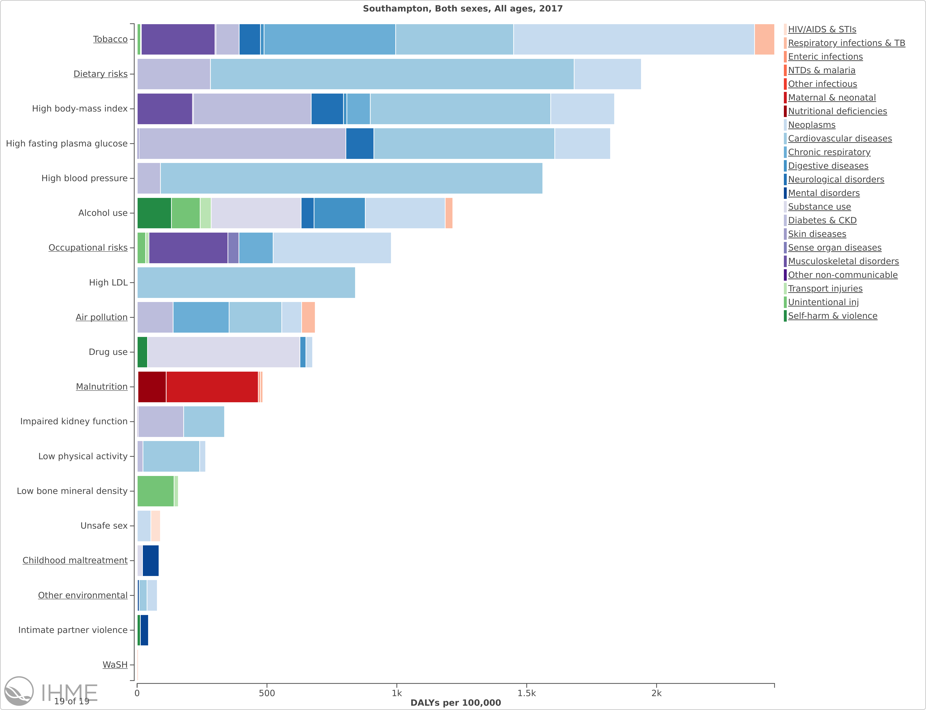
Context
Global Burden of Disease illustrates the greatest risk factors for mortality and poor health in Southampton
Measured in DALYs – disability adjusted life years lost i.e. the number of years of healthy life lost
Dietary risks and high BMI feature in the top three risk factors
Notes:
World Health Organization. Childhood overweight and obesity. http://www.who.int/dietphysicalactivity/childhood/en/
National Obesity Observatory. Health Risks of Childhood Obesity. 2016. http://www.noo.org.uk/NOO_about_obesity/child_obesity/Health_risks.

Slide 6
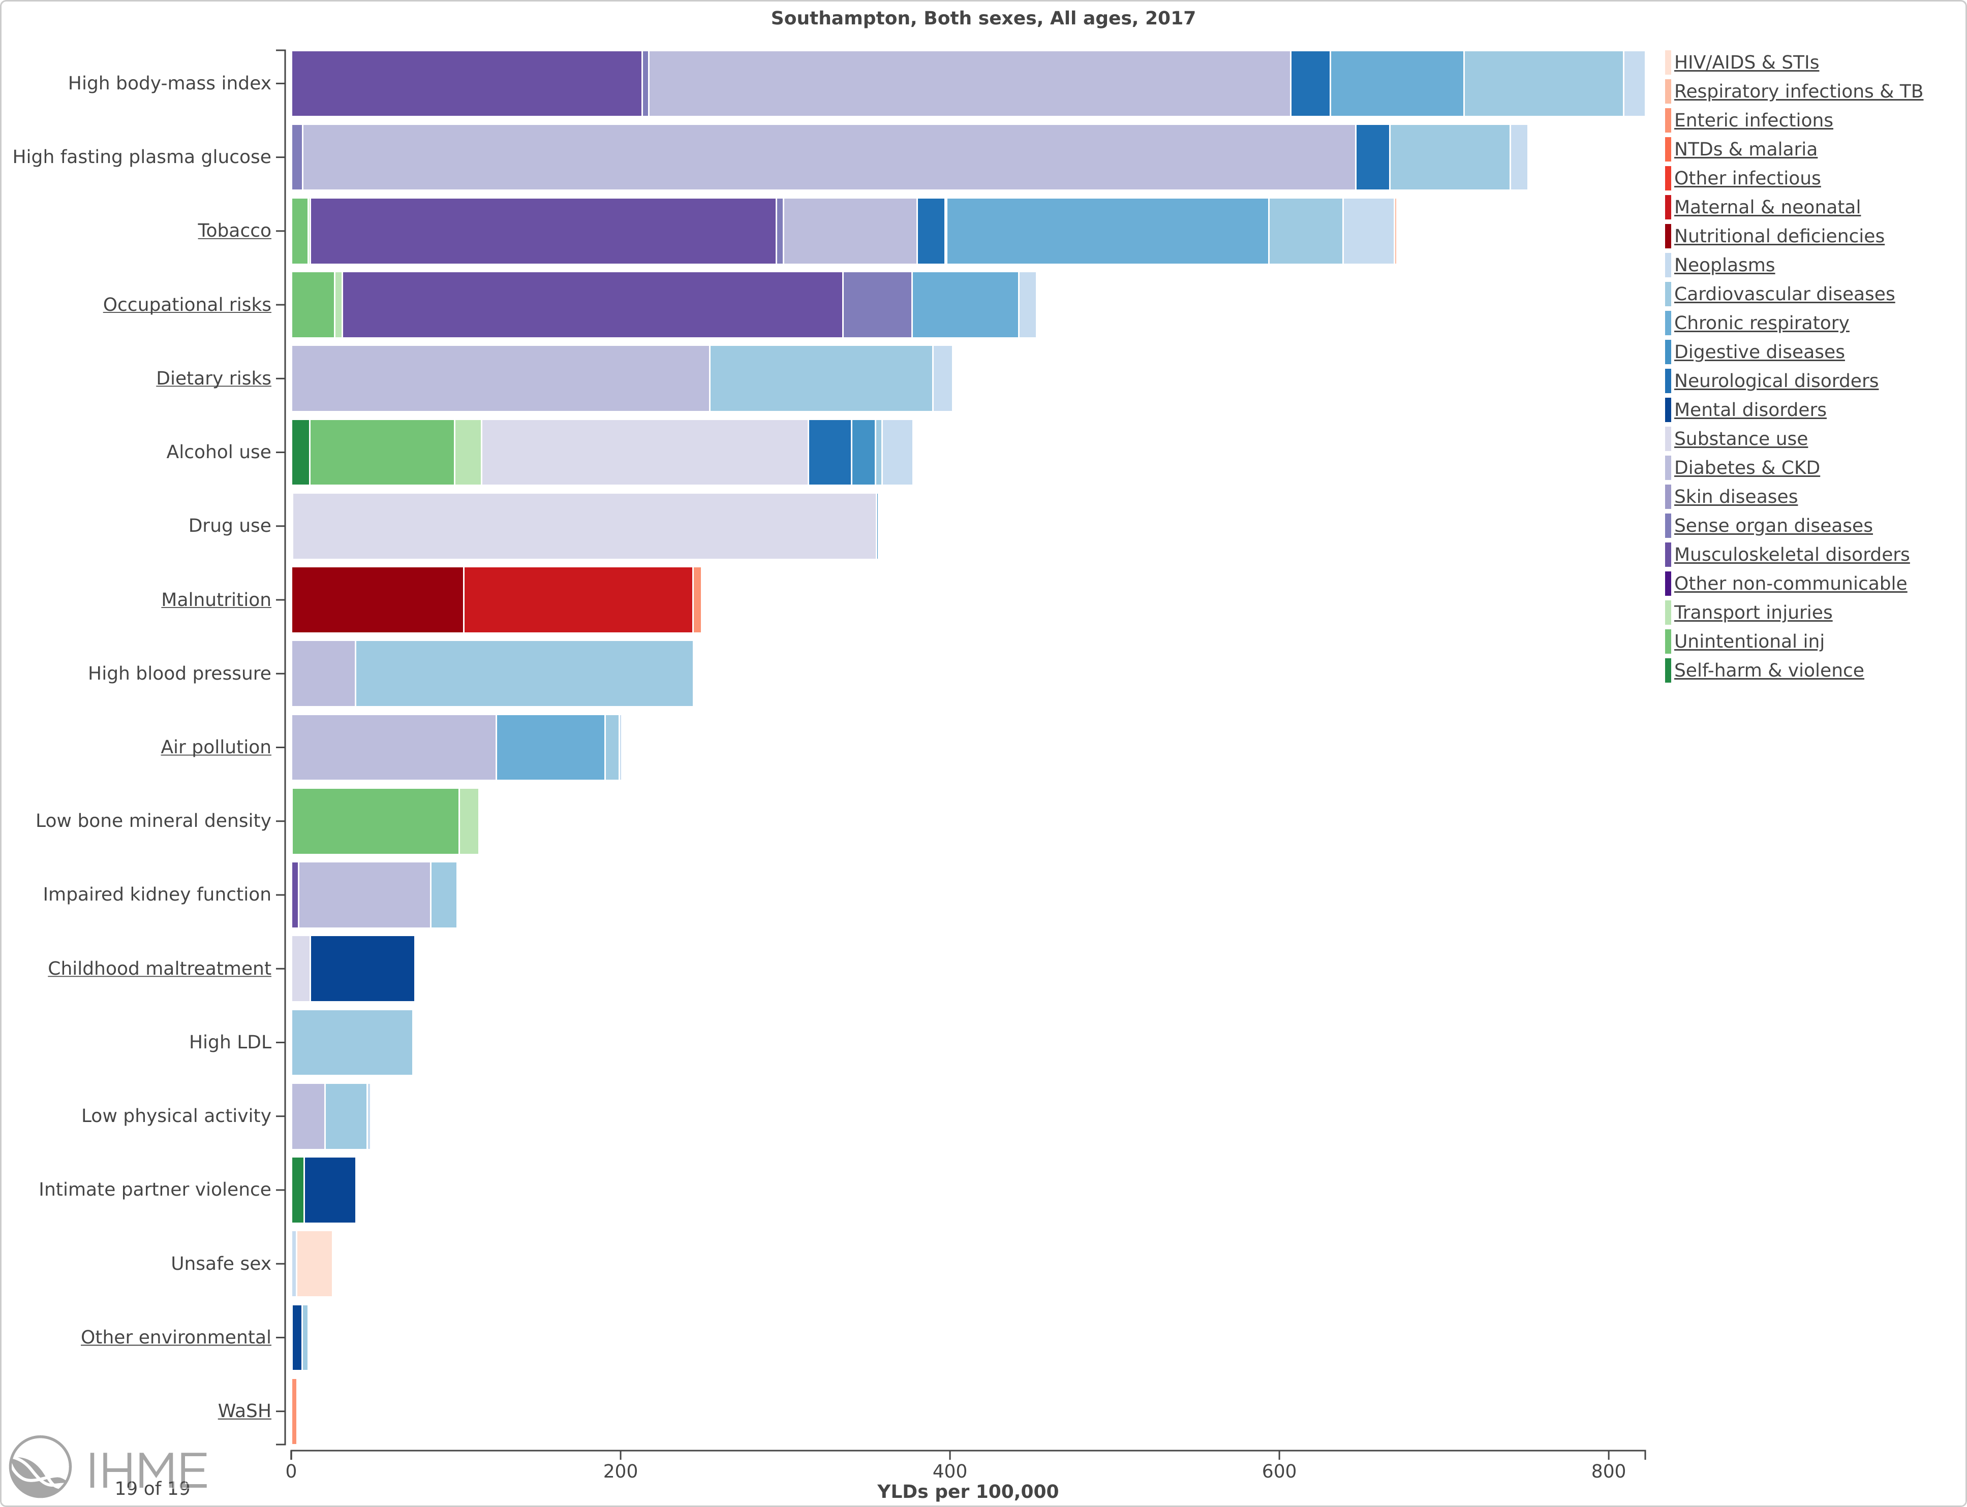
Context
If we consider the number of years lived with disability (YLD) i.e. years of life lived with any short-term or long-term health loss….
High body mass index is the top risk factor in Southampton
Illustrates the importance of tackling obesity in the city, both in terms of poor health and the costs to society
Notes:
World Health Organization. Childhood overweight and obesity. http://www.who.int/dietphysicalactivity/childhood/en/
National Obesity Observatory. Health Risks of Childhood Obesity. 2016. http://www.noo.org.uk/NOO_about_obesity/child_obesity/Health_risks.

Slide 7
How do we measure obesity?
Body Mass Index (BMI) is the accepted way of measuring obesity
divides a persons weight in kilograms by their height in metres squared
Adults are classified as overweight or obese if their BMI is above specified levels…..overweight > 25; obesity > 30
However, such levels are not appropriate for children as their BMI changes considerably with age and gender
Therefore, children’s BMI is standardised for their age and sex by comparing against a recognised standard – known as the 1990 UK standard
Notes:
The recognised standard used is the 1990 UK reference data . Importantly, this is also the standard used by NHS Digital, which allows us to make direct comparisons between Southampton and the national dataset. Standard deviation scores (z-scores) for children’s BMI are calculated and then converted to centiles (p-scores) to allow comparison with this data.
For epidemiological purposes, children can be considered underweight if they are below the 2nd centile, overweight if they are above the 85th centile, obese if above the 95th centile and severely obese if above the 98th centile. These thresholds were first recommended for obesity evaluation and treatment in the USA , and are now conventionally used for population monitoring by NHS Digital and Public Health England (PHE). They are not the same as those used in a clinical setting, where overweight and obesity are defined as greater than or equal to the 4/3 BMI z-score (91st rounded centile) and 6/3 BMI z-score (98th rounded centile) respectively.
These levels are arbitrary and a child above the 85th or indeed 91st centile is not necessarily overweight per se, as a high BMI can result from, for example, a tall child who has appropriate weight or a child who has a high lean mass. However, these cut-offs are the recognised standard for population monitoring and so have been used in this analysis.

Slide 8
How do we measure obesity?
Our primary source of information on childhood obesity comes from the National Child Measurement Programme (NCMP) introduced in 2005/06
Children are measured when they start and leave primary school
Year R (4-5 year olds) and Year 6 (10-11 year olds)
Height and weight is measured by Public Health school nurses and recorded along with various demographic information
BMI adjusted for age and sex by calculating standard deviation scores (z-scores) using the 1990 UK reference and then converted to centiles (p-scores)
Underweight: 2nd centile or below
Healthy weight: 2nd to 85th centile
Overweight: 85th centile and above
Obese: 95th centile and above
NHS number is recorded to allow individual records to be linked between time points
Local coverage is consistently higher than the national average; over 95% in last 4 years, meaning this is a very reliable dataset
Notes:
The recognised standard used is the 1990 UK reference data . Importantly, this is also the standard used by NHS Digital, which allows us to make direct comparisons between Southampton and the national dataset. Standard deviation scores (z-scores) for children’s BMI are calculated and then converted to centiles (p-scores) to allow comparison with this data.
For epidemiological purposes, children can be considered underweight if they are below the 2nd centile, overweight if they are above the 85th centile, obese if above the 95th centile and severely obese if above the 98th centile. These thresholds were first recommended for obesity evaluation and treatment in the USA , and are now conventionally used for population monitoring by NHS Digital and Public Health England (PHE). They are not the same as those used in a clinical setting, where overweight and obesity are defined as greater than or equal to the 4/3 BMI z-score (91st rounded centile) and 6/3 BMI z-score (98th rounded centile) respectively.
These levels are arbitrary and a child above the 85th or indeed 91st centile is not necessarily overweight per se, as a high BMI can result from, for example, a tall child who has appropriate weight or a child who has a high lean mass. However, these cut-offs are the recognised standard for population monitoring and so have been used in this analysis.

Slide 9
Childhood obesity data
Benchmarking
Trends
Deep dive – spatial variations

Slide 10
Context
Obesity in all our children and young people
Using the NCMP data collected in our schools, the adult national Active People Survey and all age Health Survey for England; we can estimate in Southampton there are:
Between 13,000 and 13,700 overweight/obese children aged 2 to 17 years old
With over half – between 6,700 and 7,900 are estimated obese
Notes:
ONS estimates there are 44,657 children aged 2 to 17 years in the city – 30% ish

Slide 11
NCMP - Benchmarking

Slide 12
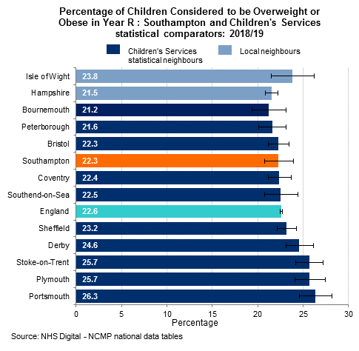
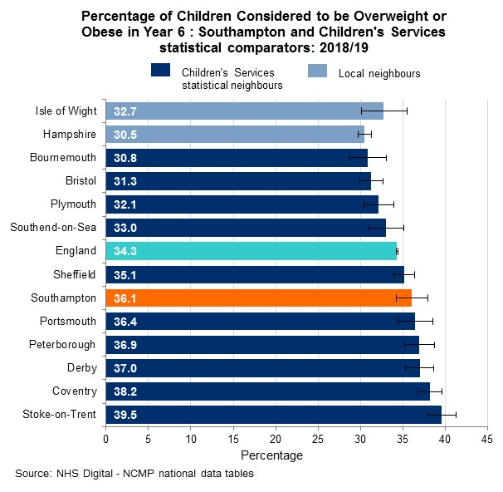
Prevalence of overweight (including obese)
2018/19: Year R – National average (22.6%); Southampton (22.3%);
Range Bournemouth (21.2%) to Portsmouth (26.3%).
Southampton 4th lowest among comparators – lower but not significantly than England.
2018/19: Year 6 – National average (34.3%); Southampton (36.1%);
Range Bournemouth (30.8%) to Stoke-on-Trent (39.5%).
Southampton mid rank among comparators and higher, not significantly than England.

Slide 13
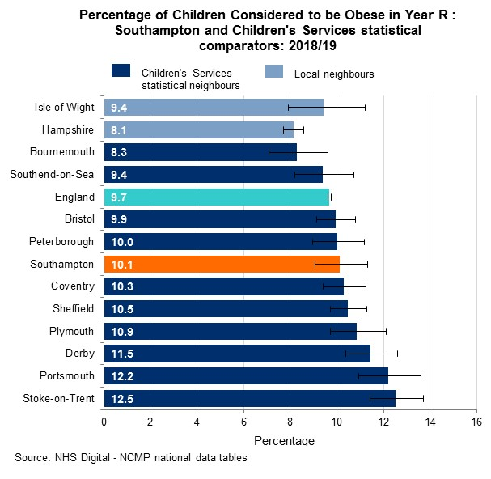
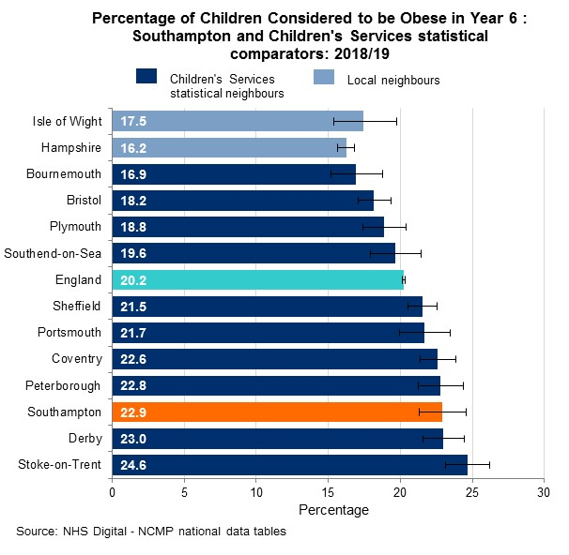
Prevalence of obese
2018/19: Year R – National average (9.7%); Southampton (10.1%); Range Bournemouth (8.3%) to Stoke-on-Trent (12.5%). Southampton mid rank among comparators, higher but not significantly than England
2018/19: Year 6 – National average (20.2%); Southampton (22.9%); Range Bournemouth (16.9%) to Stoke-on-Trent (24.6%). Southampton 3rd highest among comparators and significantly higher than England

Slide 14
NCMP - Trends

Slide 15
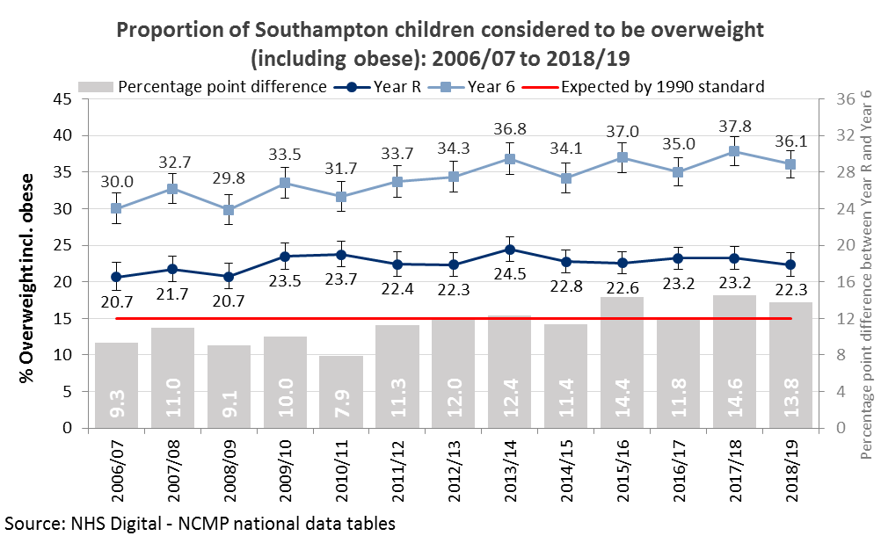
Childhood obesity trends – Overweight incl. Obese
Year R: stable over time
Year 6: statistically significant increase since 2006/07
Year 6 – Increase from 30.0% (2006/07) to 36.1% (2018/19); significantly higher
Notes:
To have the same percentage as 2006/07, 153 (153.0) overweight/obese Year 6 pupils in this year group would need to be a healthy weight

Slide 16
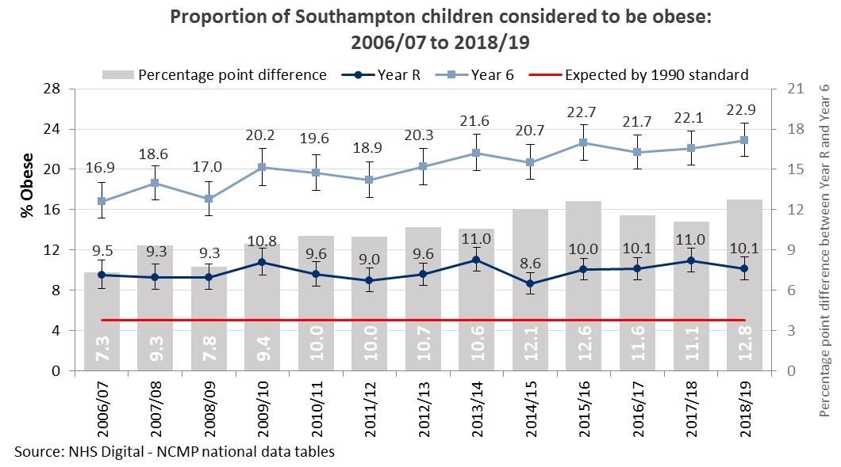
Childhood obesity trends – Obese
Year R: stable over time
Year 6: statistically significant increase since 2006/07
Year 6 – Increase from 16.9% (2006/07) to 22.9% (2018/19); significantly higher
Notes:
To have the same percentage as 2006/07, Southampton would need to have 153 (152.8) less obese Year 6 pupils

Slide 17
NCMP – Deep dive

Slide 18
Gender differences
Southampton Children 2016/17 to 2018/19
Year R – Overweight incl. obese
Year 6 – Overweight incl. obese
% Point Gap
0.3%
Statistically similar
% Point Gap
5.0%
Males significantly higher
23.1%
22.8%
38.7%
33.7%
Year R – Obese
Year 6 – Obese
% Point Gap
0.4%
Statistically similar
% Point Gap
4.3%
Males significantly higher
10.6%
10.2%
24.4%
20.0%
There is a significant difference between prevalence by gender for Year 6
Trends over time show Year R prevalence becoming statistical similar, however Year 6 gap has increased with males significantly higher than females

Slide 19
Overweight incl. Obese prevalence at Ward Level
2016/17 to 2018/19: Year R – City average (23.1%); Range Freemantle (18.8%) to Redbridge (29.2%). Redbridge and Coxford significantly higher than city prevalence
2016/17 to 2018/19: Year 6 – City average (36.3%); Range Bitterne Park (29.0%) to Millbrook (40.6%). Bitterne Park was significantly lower than city prevalence

Slide 20
Obese prevalence at Ward Level
2016/17 to 2018/19: Year R – City average (10.5%); Range Swaythling (7.2%) to Coxford (15.2%). Coxford and Redbridge again significantly higher than city prevalence
2016/17 to 2018/19: Year 6 – City average (22.4%); Range Bitterne Park (16.2%) to Bitterne (26.6%). Bitterne Park was again significantly lower than city prevalence

Slide 21
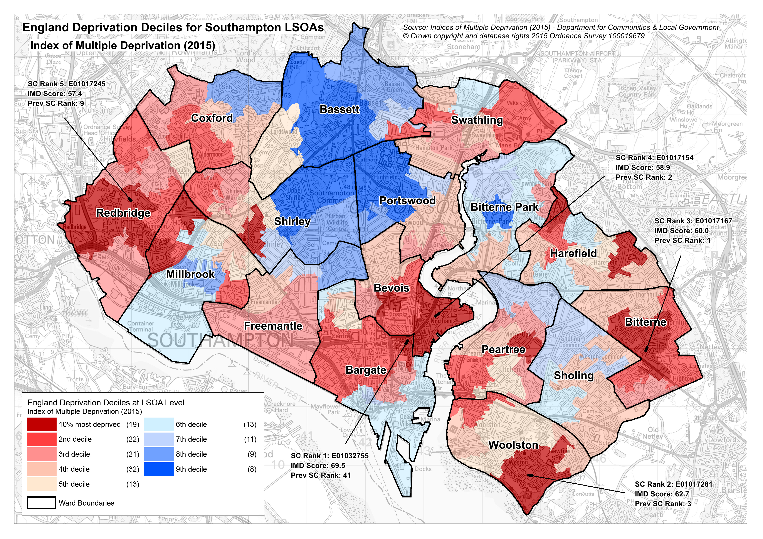
IMD (2015) – Map of ENGLAND Deprivation Deciles

Slide 22
Year R and 6 Obesity by Ward IMD 2015 score
Obesity prevalence increases as deprivation increases
Those children living in more deprived areas experience greater prevalence differences between Year R and Year 6
Notes:
This slide plots the OBESITY data from the previous slide by IMD 2015 score for each war to see if there a relationship with deprivation

Slide 23
Year 6 Obesity by IMD 2015 (Local Quintiles)
1.80 times higher most vs least deprived quintile
Gap is increasing
Higher burden is with the most deprived
Notes:
using national quintiles can mask internal deprivation, using local quintiles can mask internal affluence

Slide 24
NCMP - Linked analysis

Slide 25
Linked analysis – Southampton children
Children in Year R 2010/11 to 2012/13
6,032 linked records by NHS Number of the SAME children
Children in Year 6 2016/17 to 2018/19
Underweight
1.1%
➔ 1.6%
Healthy weight
76.5%
➔ 62.4%
Overweight
13.1%
➔ 14.0%
Obese
9.3%
➔ 22.0%

Slide 26
Linked analysis – changes in weight status in Southampton
Overweight 20.9%
Obese 8.2%
Healthy weight 70.7%
Of the 14.0% of children who were OVERWEIGHT in Year 6
The majority of overweight children in year 6 had been healthy weight in reception, whilst over a fifth had remained overweight and a further 8% had been obese
Overweight 25.9%
Healthy weight 41.1%
Obese 32.8%
Of the 22.0% of children who were OBESE in Year 6
Over two-thirds (67%) of obese children had not been obese in reception, in fact the biggest proportion was for those who had been healthy weight (41%)

Slide 27
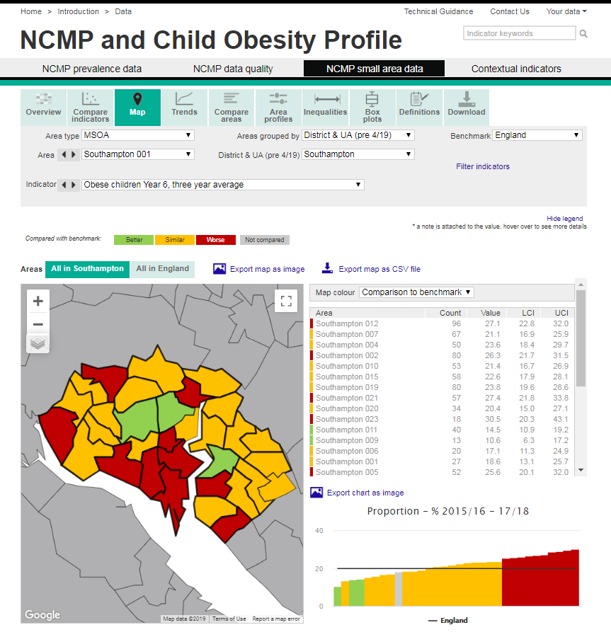
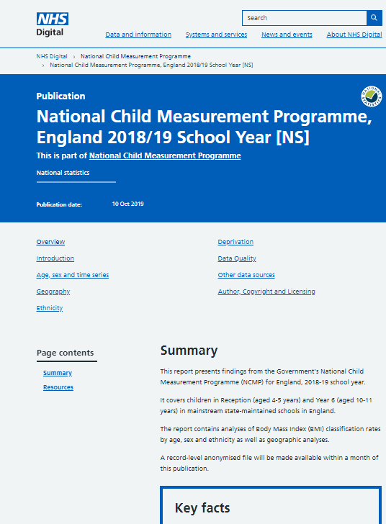
Further Information
National data and reports
NCMP Public Health England tools
Southampton Data Observatory
http://data.southampton.gov.uk/health/health-behaviours/healthy-weight/

Slide 28
Questions & Discussion
strategic.analysis@southampton.gov.uk

Slide 29
I
Intelligence & Strategic Analysis Team
Southampton City Council
E-mail: strategic.analysis@southampton.gov.uk
Website: data.southampton.gov.uk
Municipal Block – West, Civic Centre, Southampton, SO14 7LT

